Slide 1
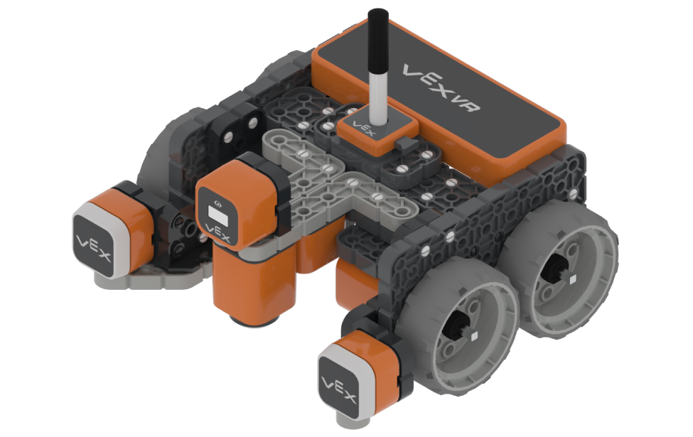
Wall Maze
http://vr.vex.com

Slide 2
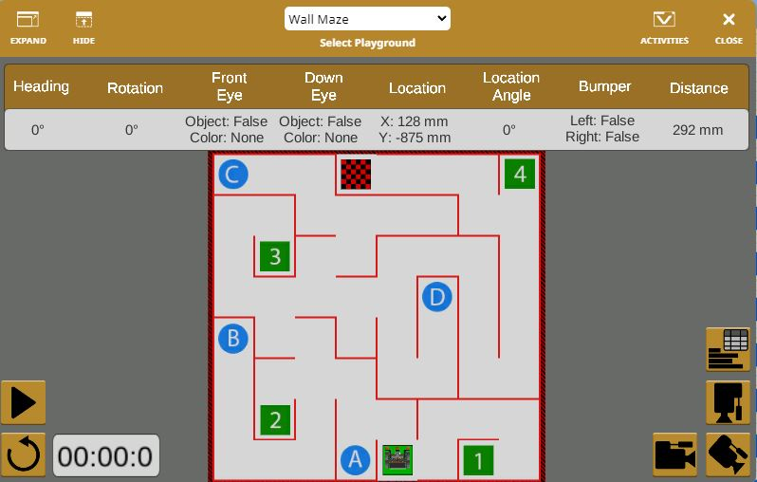
Playground Number Maze

Slide 3
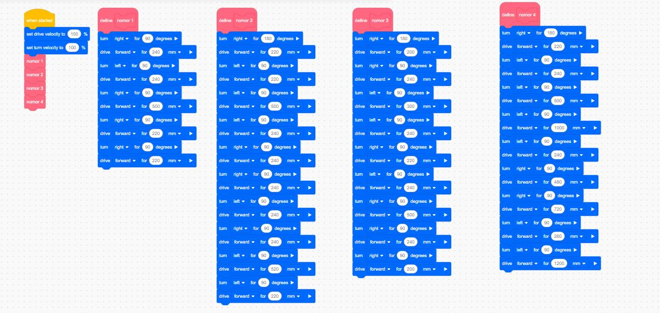
Code Number Maze

Slide 4
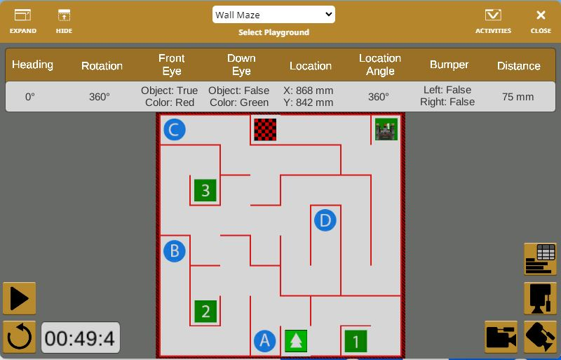
Playground Hasil

Slide 5
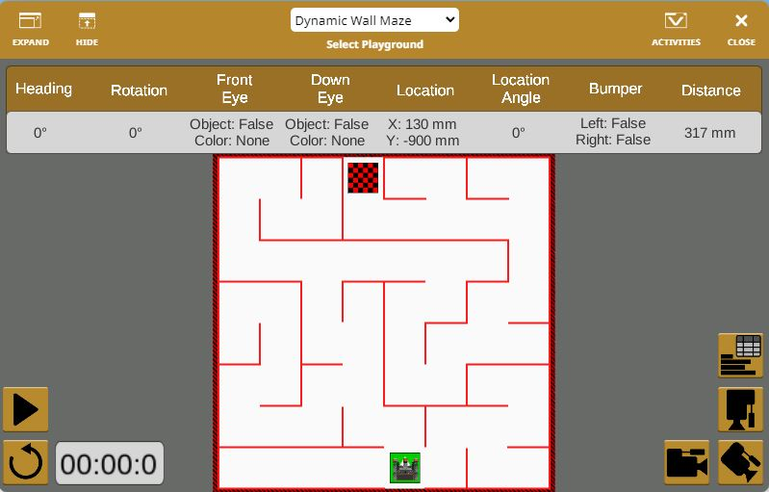
Playground Dynamic Maze

Slide 6
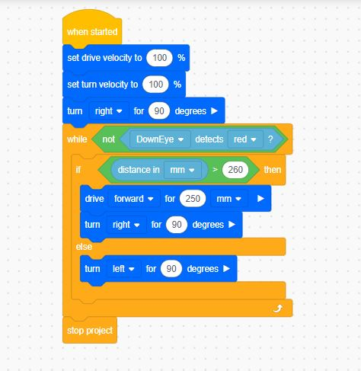
Code Dynamic Maze

Slide 7
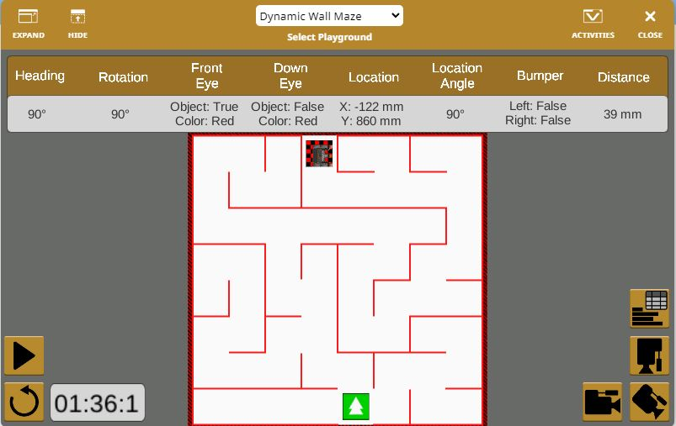
Playground

